Slide 1

Chapter 2 ~ Basic Relationship Between Pixels
Heaven’s Light is Our Guide
Department of Computer Science & Engineering
Rajshahi University of Engineering & Technology, Rajshahi-6204, Bangladesh.
S. M. Mahedy Hasan
Assistant Professor, Dept. of CSE
RUET, Rajshahi-6204, Bangladesh.

Slide 2
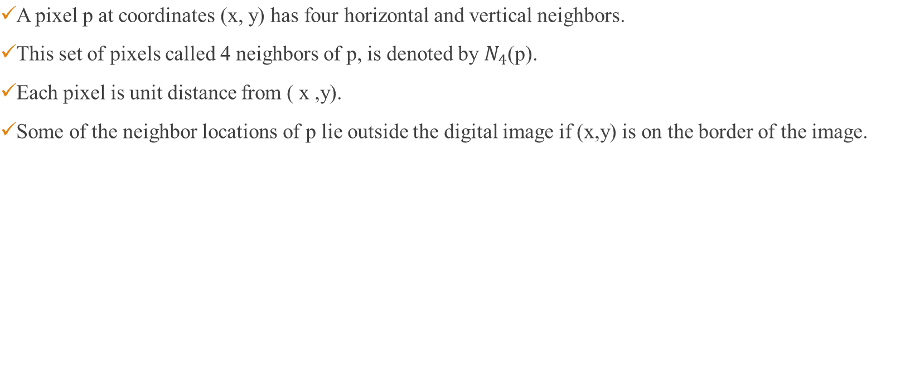
Neighbors of a pixel
x
 |  | (x,y-1)
 | (x-1,y) | p(x,y) | (x+1,y)
 |  | (x,y+1)
y
SOME BASIC RELATIONSHIP BETWEEN PIXELS
Notes:
Some Basic Relationship Between Pixels

Slide 3
Neighbors of a Pixel
The four diagonal neighbors of p at coordinates (x, y) is denoted by N_{D}(p).
x
 | (x-1,y-1) |  | (x+1,y-1)
 |  | p(x,y)
 | (x-1,y+1) |  | (x+1,y+1)
y
SOME BASIC RELATIONSHIP BETWEEN PIXELS
Notes:
Help Link: http://users.wfu.edu/matthews/misc/DigPhotog/alias/
Some Basic Relationship Between Pixels

Slide 4
Neighbors of a Pixel
The 8-neighbors of p at coordinates (x,y), denoted by N₈(p).
x
 | (x-1,y-1) | (x,y-1) | (x+1,y-1)
 | (x-1,y) | p(x,y) | (x+1,y)
 | (x-1,y+1) | (x,y+1) | (x+1,y+1)
y
SOME BASIC RELATIONSHIP BETWEEN PIXELS
Notes:
Help Link: http://users.wfu.edu/matthews/misc/DigPhotog/alias/
Some Basic Relationship Between Pixels

Slide 5
Adjacency
Two pixels are adjacent if they are neighbors and their intensity level ‘V’ satisfy some specific criteria of similarity.
Let V be the set of intensity values used to define adjacency.
  Binary Image : V⊂{0,1}
  Gray Image : V ⊂{0,1,2, …, 255}
In binary images, 2 pixels are adjacent if they are neighbors & have some intensity values either 0 or 1.
SOME BASIC RELATIONSHIP BETWEEN PIXELS
Notes:
Help Link: http://users.wfu.edu/matthews/misc/DigPhotog/alias/
Some Basic Relationship Between Pixels

Slide 6
Adjacency
Three types of adjacency:
4-adjacency: Two pixels p and q with the values from set ‘V’ are 4-adjacent if q is in the set of N4(p).
For example, V = { 0, 1}
1 1 0
1 1 0
1 0 1
Here, p in RED color q can be any value in GREEN color.
SOME BASIC RELATIONSHIP BETWEEN PIXELS
Notes:
Help Link: http://users.wfu.edu/matthews/misc/DigPhotog/alias/
Some Basic Relationship Between Pixels

Slide 7
Adjacency
Three types of adjacency:
8-adjacency: Two pixels p and q with the values from set ‘V’ are 8-adjacent if q is in the set of N₈(p).
For example, V = { 1, 2}
0 1 1
0 2 0
0 0 1
p in RED color and q can be any value in GREEN color.
SOME BASIC RELATIONSHIP BETWEEN PIXELS
Notes:
Help Link: http://users.wfu.edu/matthews/misc/DigPhotog/alias/
Some Basic Relationship Between Pixels

Slide 8
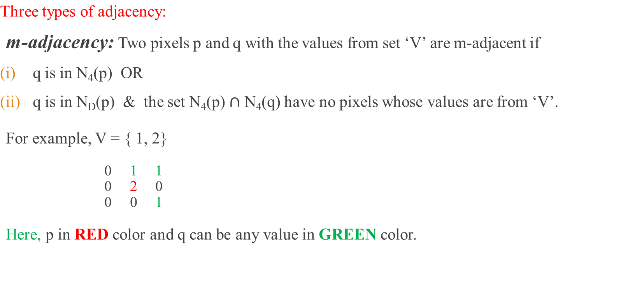
Adjacency
SOME BASIC RELATIONSHIP BETWEEN PIXELS
Notes:
Help Link: http://users.wfu.edu/matthews/misc/DigPhotog/alias/
Some Basic Relationship Between Pixels

Slide 9
Adjacency
m-adjacency: Two pixels p and q with the values from set ‘V’ are m-adjacent if
q is in N₄(p)
For example, V = { 1 }
(i) b & c
0 a 1 b 1 c
0 d 1 e 0 f
0 g 0 h 1 I
Solution: b & c are m-adjacent.
SOME BASIC RELATIONSHIP BETWEEN PIXELS

Slide 10
Adjacency
m-adjacency: Two pixels p and q with the values from set ‘V’ are m-adjacent if
q is in N₄(p)
For example, V = { 1 }
(ii) b & e
0 a 1 b 1 c
0 d 1 e 0 f
0 g 0 h 1 I
Solution: b & e are m-adjacent.
SOME BASIC RELATIONSHIP BETWEEN PIXELS

Slide 11
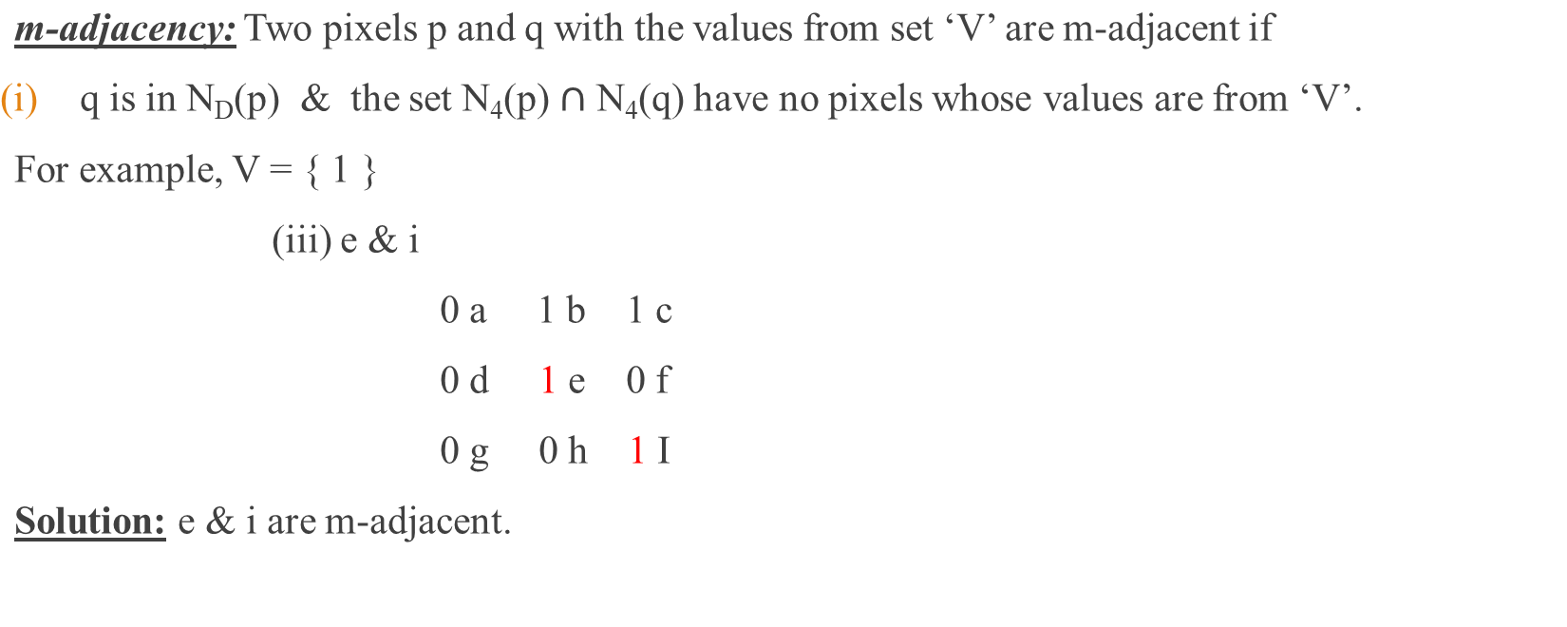
Adjacency
SOME BASIC RELATIONSHIP BETWEEN PIXELS

Slide 12
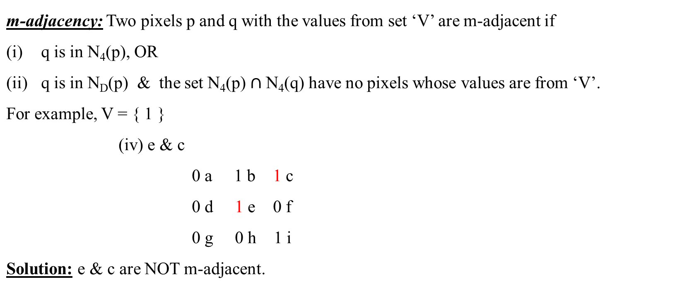
Adjacency
SOME BASIC RELATIONSHIP BETWEEN PIXELS

Slide 13
Connectivity
Two pixels are said to be connected:
If they are adjacent in some sense (neighbor pixels, 4/8/m-adjacency)
If their gray levels satisfy a specified criterion of similarity (equal intensity level)
There are three types of connectivity on the basis of adjacency:
4-connectivity: Two or more pixels are said to be 4-connected if they are 4-adjacent with each others.
8-connectivity: Two or more pixels are said to be 8-connected if they are 8-adjacent with each others.
m-connectivity: Two or more pixels are said to be m-connected if they are m-adjacent with each others.
SOME BASIC RELATIONSHIP BETWEEN PIXELS
Notes:
Help Link: http://users.wfu.edu/matthews/misc/DigPhotog/alias/
Some Basic Relationship Between Pixels

Slide 14
Paths
Example # 1: Consider the image segment shown in figure. Compute length of the shortest-4, shortest-8 & shortest-m paths between pixels p & q where, V = {1, 2}.
4 2 3 2 q
3 3 1 3
2 3 2 2
p 2 1 2 3
SOME BASIC RELATIONSHIP BETWEEN PIXELS

Slide 15
Paths
Example # 1: Shortest 4-Path does not exist.
4 | 2 | 3 | 2 q
3 | 3 | 1 | 3
2 | 3 | 2 | 2
2 p | 1 | 2 | 3
SOME BASIC RELATIONSHIP BETWEEN PIXELS

Slide 16
Paths
Example # 1: Shortest 8-Path = 4.
4 | 2 | 3 | 2 q
3 | 3 | 1 | 3
2 | 3 | 2 | 2
2 p | 1 | 2 | 3
SOME BASIC RELATIONSHIP BETWEEN PIXELS

Slide 17
Paths
Example # 1: Shortest m-Path = 5.
4 | 2 | 3 | 2 q
3 | 3 | 1 | 3
2 | 3 | 2 | 2
2 p | 1 | 2 | 3
SOME BASIC RELATIONSHIP BETWEEN PIXELS

Slide 18
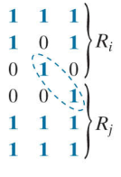
Regions
A region in an image is a group of connected pixels with similar properties.
Let R be a subset of pixels in an image. We call R a region of the image if R is a connected set.
Regions that are not adjacent are said to be disjoint.
Two regions (of 1s) that are adjacent if 8-adjecency is used.
SOME BASIC RELATIONSHIP BETWEEN PIXELS
Notes:
Help Link: http://users.wfu.edu/matthews/misc/DigPhotog/alias/
Some Basic Relationship Between Pixels

Slide 19
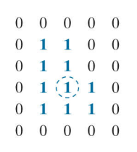
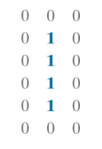
Boundary
Set of pixels in the region that have one or more neighbors that are not in R.
The boundary (also called the border or contour) of a region R is the set of pixels in R that are adjacent to pixels in the complement of R.
Stated another way, the border of a region is the set of pixels in the region that have at least one background neighbor.
Outer Boundary
Inner Boundary
SOME BASIC RELATIONSHIP BETWEEN PIXELS
Notes:
Help Link: http://users.wfu.edu/matthews/misc/DigPhotog/alias/
Some Basic Relationship Between Pixels

Slide 20
Boundary
If R happens to be an entire image (which we recall is a rectangular set of pixels), then its boundary is defined as the set of pixels in the first and last rows and columns of the image.
This extra definition is required because an image has no neighbors beyond its border.
1 | 1 | 1 | 1
1 | 1 | 1 | 1
1 | 1 | 1 | 1
1 | 1 | 1 | 1
SOME BASIC RELATIONSHIP BETWEEN PIXELS
Notes:
Help Link: http://users.wfu.edu/matthews/misc/DigPhotog/alias/
Some Basic Relationship Between Pixels

Slide 21
Distance Measures
For pixels p(x, y), q(s, t) and z(u, v), D is a distance function or metric if
D(p, q) ≥ 0
(D(p, q) = 0, if p = q)
D(p, q) = D(q, p)
D(p, z) ≤ D(p, q) + D(q, z)
 | p(x, y)
z(u, v) |  |  |  | q(s, t)
SOME BASIC RELATIONSHIP BETWEEN PIXELS
Notes:
Help Link: http://users.wfu.edu/matthews/misc/DigPhotog/alias/
Some Basic Relationship Between Pixels

Slide 22
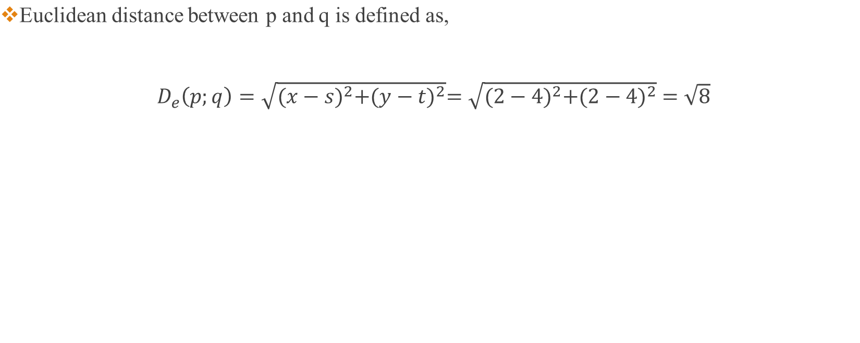
Euclidean Distance
 | P(x, y)
 |  |  | q(s, t)
SOME BASIC RELATIONSHIP BETWEEN PIXELS
Notes:
Help Link: http://users.wfu.edu/matthews/misc/DigPhotog/alias/
Some Basic Relationship Between Pixels

Slide 23
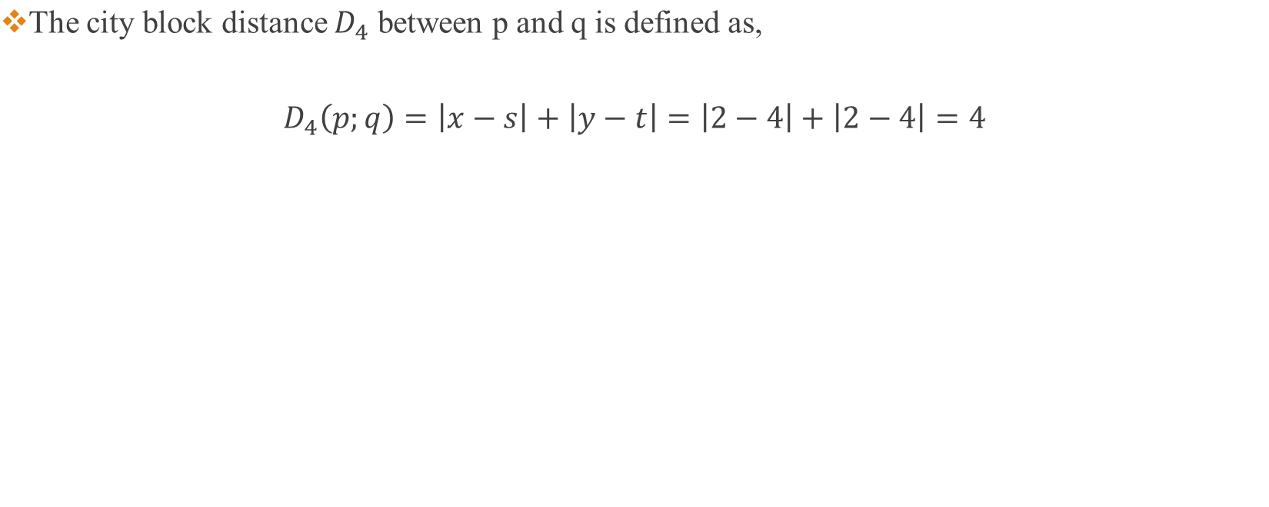
City Block Distance
 | P(x, y)
 |  |  | q(s, t)
SOME BASIC RELATIONSHIP BETWEEN PIXELS
Notes:
Help Link: http://users.wfu.edu/matthews/misc/DigPhotog/alias/
Some Basic Relationship Between Pixels

Slide 24
City Block Distance
?? | ?? | 2 | ?? | =??
?? | 2 | 1 | 2 | ??
2 | 1 | 0 | 1 | 2
?? | 2 | 1 | 2 | ??
?? | ?? | 2 | ?? | ??
SOME BASIC RELATIONSHIP BETWEEN PIXELS
Notes:
Help Link: http://users.wfu.edu/matthews/misc/DigPhotog/alias/
Some Basic Relationship Between Pixels

Slide 25
City Block Distance
4 | 3 | 2 | 3 | 4
3 | 2 | 1 | 2 | 3
2 | 1 | 0 | 1 | 2
3 | 2 | 1 | 2 | 3
4 | 3 | 2 | 3 | 4
SOME BASIC RELATIONSHIP BETWEEN PIXELS
Notes:
Help Link: http://users.wfu.edu/matthews/misc/DigPhotog/alias/
Some Basic Relationship Between Pixels

Slide 26
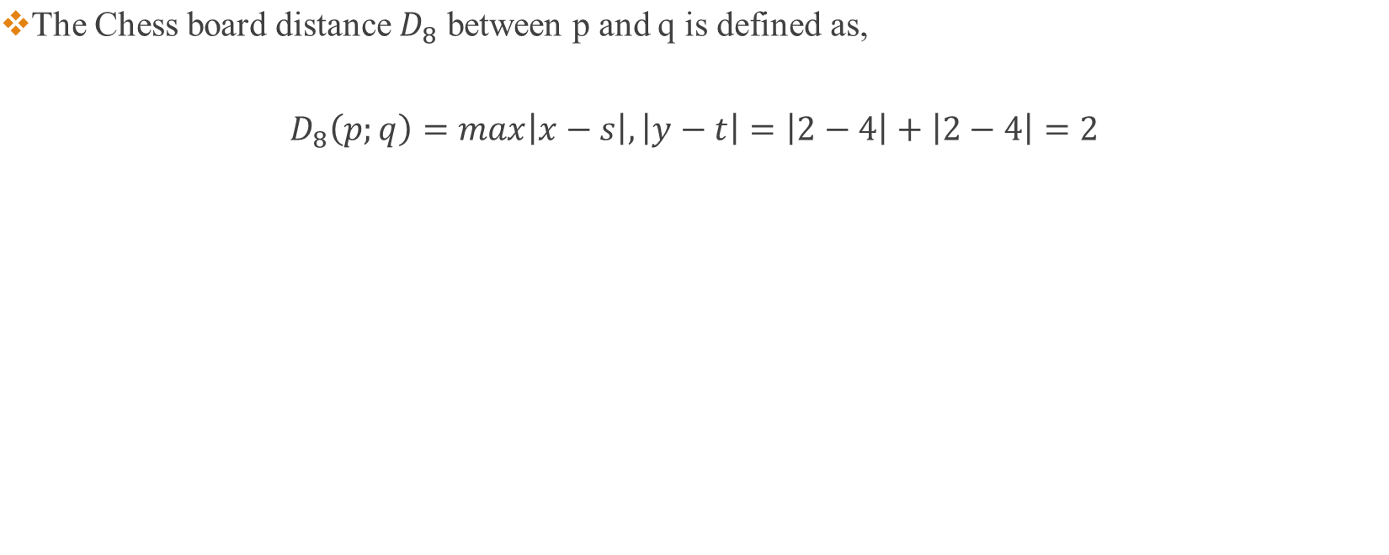
Chess Board Distance
 | P(x, y)
 |  |  | q(s, t)
SOME BASIC RELATIONSHIP BETWEEN PIXELS
Notes:
Help Link: http://users.wfu.edu/matthews/misc/DigPhotog/alias/
Some Basic Relationship Between Pixels

Slide 27
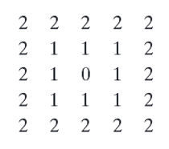
Chess Board Distance
SOME BASIC RELATIONSHIP BETWEEN PIXELS
Notes:
Help Link: http://users.wfu.edu/matthews/misc/DigPhotog/alias/
Some Basic Relationship Between Pixels

Slide 28
Thank You ☺
SOME BASIC RELATIONSHIP BETWEEN PIXELS

